Slide 1
Real-time Stress Detection on Social Network Posts using Big Data Technology
JYOTI SINGH (122AD0020)
VASANTHA (122AD0030)

Slide 2
Problem Statement
The Challenge
Traditional stress detection techniques often involve wearable devices or lab-based tests, which are not scalable for monitoring large populations. On the other hand, analyzing text data from social media introduces challenges like language ambiguity, context dependence, and the need for high-speed data processing.
Key Problem Areas
- Detecting stress without physiological data.
- Processing and analyzing massive amounts of unstructured social media text in real time.
- Building models that generalize well across different topics, user styles, and linguistic variations.
Goal
Design a scalable, real-time stress detection system that can process social media streams, analyze text, and classify posts as stressed or non-stressed with high accuracy

Slide 3
Introduction
Context
The widespread adoption of social media platforms has made them a major outlet for people to express their emotions, thoughts, and life experiences. Posts reflecting stress, anxiety, or distress can be valuable indicators of mental health issues.
Relevance
Detecting stress in social media posts can enable early interventions, personalized mental health support, and broader insights into public mental well-being. Traditional methods rely on clinical or physiological data, which are hard to scale — making text-based analysis a more practical approach.
Objective
Leverage big data technologies to build a real-time system capable of identifying stress in social media text, specifically Reddit posts, using machine learning and deep learning models.

Slide 4
Literature Survey
Traditional Approaches to Stress Detection
Physiological Methods
-Use sensors to measure heart rate, blood pressure, and galvanic skin response.
-While accurate, these methods lack scalability for large populations.
Survey-Based Techniques
-Self-reported stress questionnaires and clinical interviews.
-Subjective, time-consuming, and impractical for continuous monitoring.

Slide 5
Text-Based and Computational Approaches
Natural Language Processing (NLP) Models
- Sentiment analysis and emotion detection techniques.
- Text classification using Bag-of-Words (BoW), TF-IDF, and word embeddings.
Machine Learning & Deep Learning
- Logistic Regression, Random Forest, and Support Vector Machines for text classification.
- Transformers and recurrent models (like LSTMs) for context-aware stress detection.
Big Data Technology
- Tools like Apache Kafka, Spark Streaming, and Spark MLlib enable real-time data collection and analysis.

Slide 6
Limitations of Existing Methods
Physiological Methods
- Invasive and hard to scale for large populations.
- Not suitable for passive, continuous monitoring in natural settings.
Text-Based Approaches
- Can struggle with sarcasm, slang, and evolving language patterns.
- Performance varies across platforms (e.g., Twitter vs. Reddit) due to text length and structure.
Computational Constraints
- Real-time stress detection requires fast, distributed systems to handle high-volume social media data streams.

Slide 7
Methodology
Data Preprocessing & Feature Engineering
Data Preprocessing
Essential for handling noisy, complex social media text data.
Steps involved:
Noise Removal: Eliminate links, special characters, and emoticons.
Stopword Removal: Remove common, non-informative words.
Lowercasing & Tokenization: Normalize text and split into tokens.
Feature Engineering
Converts raw data into suitable model features.
Key techniques:
String Indexer: Encodes categorical features as numerical values.
Word2Vec Embedding: Captures semantic meaning in text.
Vector Assembler: Combines multiple features into a single vector.
Data Standardization: Ensures uniform feature scaling.

Slide 8
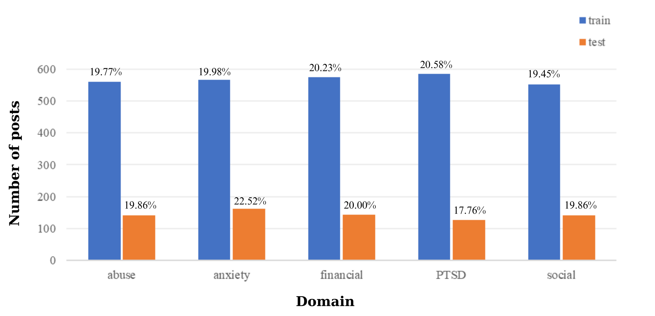
Figure 2: The chart of representation of the number and proportion of posts in 5 domains on the training and test set

Slide 9
Machine & Deep Learning Models
Machine Learning Models (Spark MLlib)
Logistic Regression: Classifies using a sigmoid function.
Random Forest: Combines decision trees via majority voting.
Decision Trees: Greedily partitions data to optimize class purity.
Gradient-Boosted Trees: Sequentially corrects previous errors.
Support Vector Machines (SVM): Finds optimal class boundaries.
Deep Learning Models (Transformers)
BERT: Captures bidirectional context for rich representations.
RoBERTa: Optimized BERT variant with better training strategies.
DistilBERT: Lightweight BERT for faster, efficient inference.
XLNet: Uses permutation language modeling for better text understanding.
Electra: Trains through discriminative pretraining for data efficiency.

Slide 10
Big Data & Real-Time Technologies
Apache Spark (for Large-Scale Data Processing)
In-memory distributed computing framework.
Components used:
MLlib: Build scalable machine learning models.
Structured Streaming: Handle real-time data flows.
Apache Kafka (for Real-Time Streaming)
High-throughput distributed event streaming platform.
Manages continuous data streams from Reddit.
Supports temporary data storage and integration with Spark for live analysis.
Apache Airflow (Workflow Orchestration)
Automates and schedules complex data pipelines.
Manages data ingestion, preprocessing, and model training workflows.
Ensures smooth coordination between Spark and Kafka tasks.

Slide 11
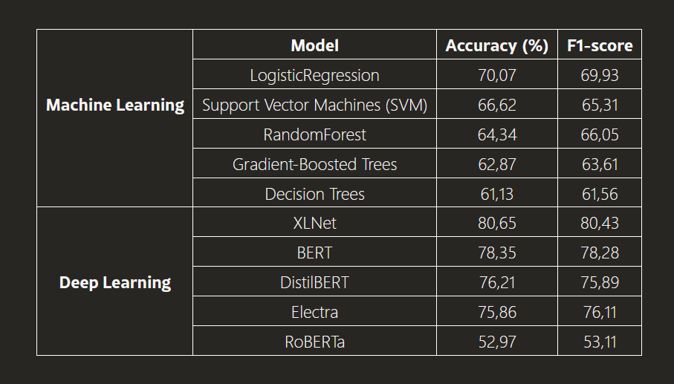
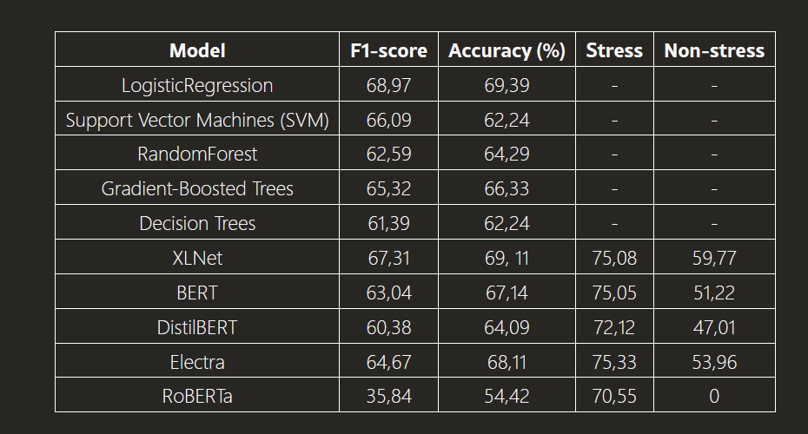
TABLE I: Evaluation results of model performance on sample data
TABLE II: Evaluation results of model when predicting new streaming data

Slide 12
Experimental Results
Observations
DL models outperformed ML models on larger datasets, especially XLNet.
DL models struggled with small datasets and low label variety.
Stress Detection Bias: DL models recognized stress samples well , but struggled with non-stress samples.
Conclusion
ML models are more reliable for smaller, imbalanced datasets.
DL models (especially XLNet) excel with richer, larger datasets but may require careful fine-tuning for class balance.

Slide 13
Real-Time Stress Detection Workflow
Step 1: Stream data collection using Reddit API.
Step 2: Data ingestion and distribution via Apache Kafka.
Step 3: On-the-fly text preprocessing and feature extraction
using Spark.
Step 4: Stress classification using the trained machine learning model.
Step 5: Results storage and alert generation for stressed posts.

Slide 14
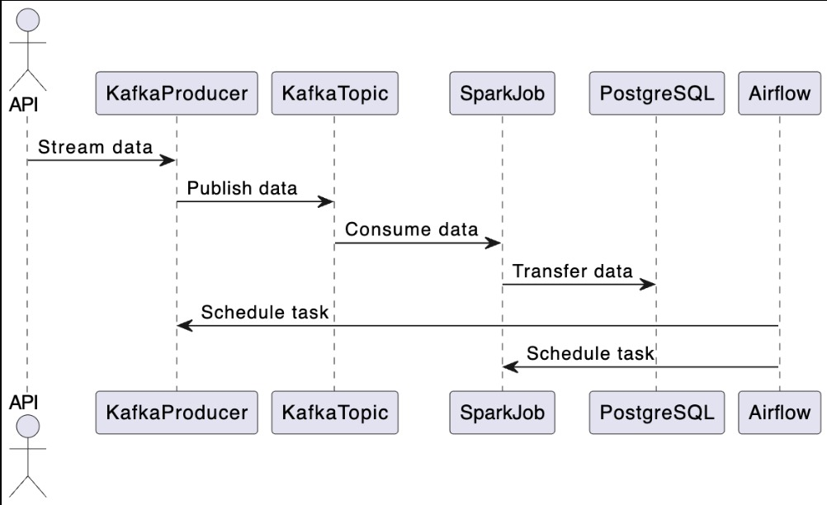
Project Architecture

Slide 15
Future Work
Dataset Expansion
- Collect and label more posts to improve model generalization.
- Include data from platforms like Twitter and Facebook for multi-platform analysis.
Model Improvements
-Further fine-tune transformer models (BERT, RoBERTa, XLNet) with domain-specific pre-training.
-Explore ensemble techniques (e.g., stacking, voting) to boost accuracy and F1-score.
System Enhancements
Integrate temporal analysis to track users' emotional patterns over time.
Add sentiment intensity scoring or stress level categorization for more nuanced insights.

Slide 16
References
A. Ghaderi et al., "Machine learning-based signal processing for stress detection," ICBME, 2015.
M. Salai et al., "Stress detection using heart rate sensors," Journal of Healthcare Engineering, 2016.
O. R. M. S. Sriramprakash et al., "Stress detection in working people," Procedia Computer Science, 2017.

Slide 17
A. Ahmed et al., "ML models to detect anxiety via social media," Computer Methods in Programs in Biomedicine Update, 2022.
Y. Kim, "CNNs for sentence classification," EMNLP, 2014.
E. Turcan, K. McKeown, "Dreaddit: Reddit dataset for stress analysis," LOUHI 2019, 2019.

Slide 18
Thank You

